Slide 1
Wav2vec 2.0 et al.
Presented by Sanyuan Chen
Jan 07, 2022

Slide 2
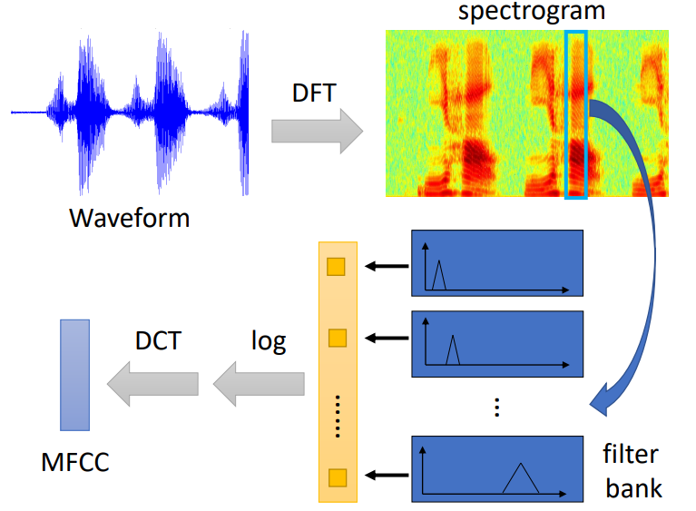
Acoustic Feature
STFT feature
fBank feature
logfBank feature
MFCC feature
Can we learn contextual and high-level representation with self-supervised learning on large-scale unlabeled data?

Slide 3
SSL
Generative modeling
Reconstruct acoustic feature -> MSE loss
computationally intense, waste capacity
Discriminative modeling
Contrastive Learning (e.g. wav2vec 2.0)
Discriminate positive samples from random selected negative samples
Mask Language modeling (e.g. HuBERT)
Offline tokenization, then predict token with CE loss
Notes:
powerful conditional generative models which need to reconstruct every detail in the data are usually required. But these models are computationally intense, and waste capacity at modeling the complex relationships in the data x, often ignoring the context c

Slide 4
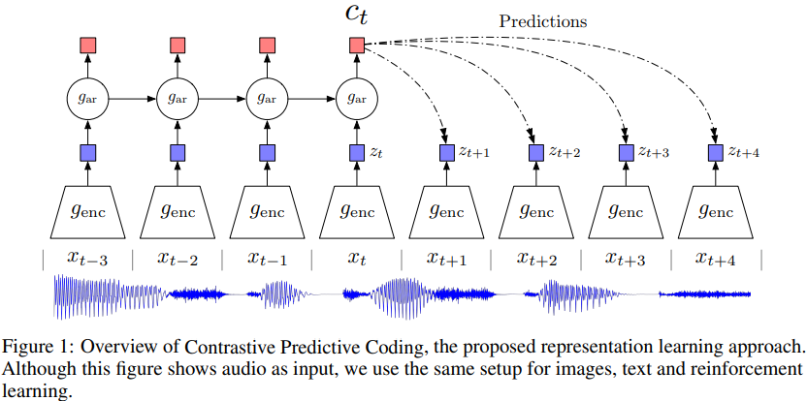
Contrastive Predictive Coding (CPC)
Oord et al. DeepMind. Jan 2019. https://arxiv.org/pdf/1807.03748.pdf
Notes:
采样得到latent vector, 每帧代表10ms
自回归模型(GRUs)建模context vector，预测未来k时刻的latent vector, negative samples random samples from p(x) in the minibatch
MI loss cross entropy loss
either of zt and ct could be used as representation for downstream tasks, zt context
预测12步最好，从相同的speaker，包括当前的sequence里sample negative最好

Slide 5
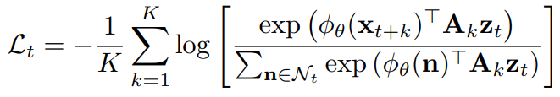
Contrastive Predictive Coding (CPC)
Oord et al. DeepMind. Jan 2019. https://arxiv.org/pdf/1807.03748.pdf
Notes:
采样得到latent vector, 每帧代表10ms
自回归模型(GRUs)建模context vector，预测未来k时刻的latent vector, negative samples random samples from p(x) in the minibatch
MI loss cross entropy loss
either of zt and ct could be used as representation for downstream tasks, zt context
预测12步最好，从相同的speaker，包括当前的sequence里sample negative最好

Slide 6
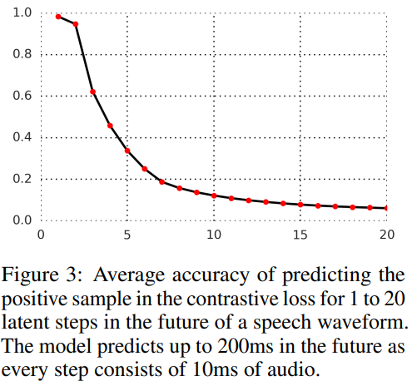
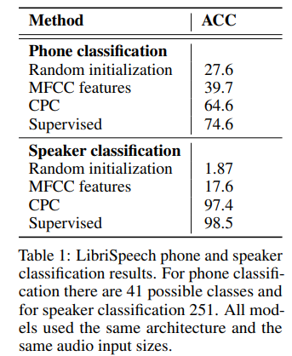
Contrastive Predictive Coding (CPC)
Oord et al. DeepMind. Jan 2019. https://arxiv.org/pdf/1807.03748.pdf
Notes:
采样得到latent vector, 每帧代表10ms
自回归模型(GRUs)建模context vector，预测未来k时刻的latent vector, negative samples random samples from p(x) in the minibatch
MI loss cross entropy loss
either of zt and ct could be used as representation for downstream tasks, zt context
预测12步最好，从相同的speaker，包括当前的sequence里sample negative最好

Slide 7
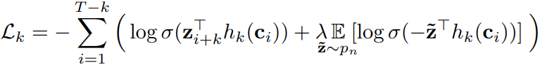
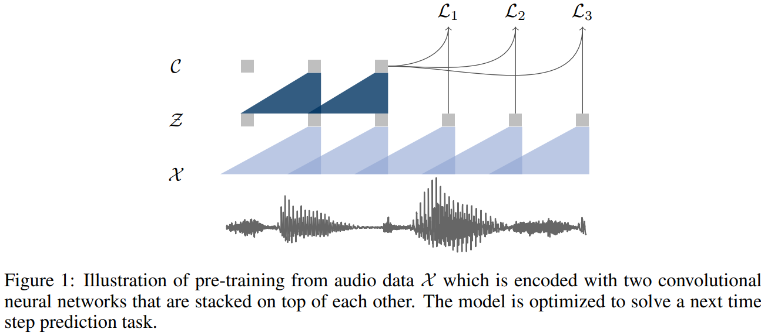
Wav2vec
Schneider et al. FAIR. Sep 2019. https://arxiv.org/pdf/1904.05862.pdf
Notes:
不只是phoneme class,而是ASR
Fully CNN -> 并行效率
Binary cross entropy loss
Receptive field of z is 30ms, c is 210ms/ 810ms
Encoder 5 CNN, context network: 9 CNN / 12 CNN
Negatives from same sequence, 10最好

Slide 8
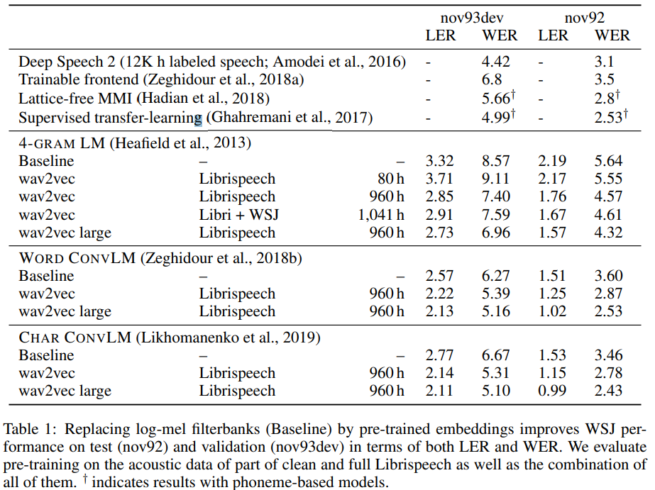
Wav2vec
Schneider et al. FAIR. Sep 2019. https://arxiv.org/pdf/1904.05862.pdf
Notes:
不只是phoneme class,而是ASR
Fully CNN -> 并行效率
Receptive field of z is 30ms, c is 210ms/ 810ms
Encoder 5 CNN, context network: 9 CNN / 12 CNN
Negatives from same sequence

Slide 9
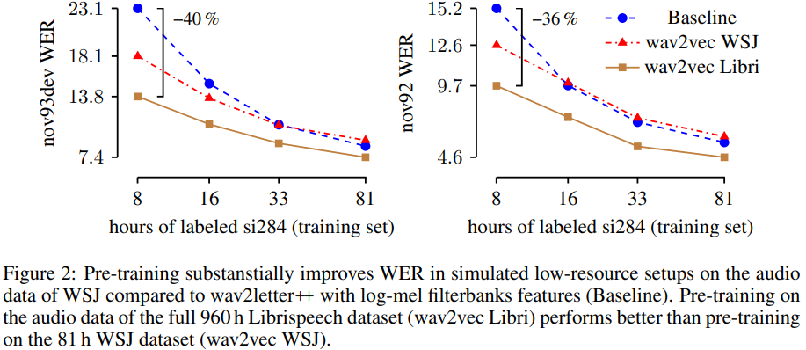
Wav2vec
Schneider et al. FAIR. Sep 2019. https://arxiv.org/pdf/1904.05862.pdf
Notes:
不只是phoneme class,而是ASR
Fully CNN -> 并行效率
Receptive field of z is 30ms, c is 210ms/ 810ms
Encoder 5 CNN, context network: 9 CNN / 12 CNN
Negatives from same sequence

Slide 10
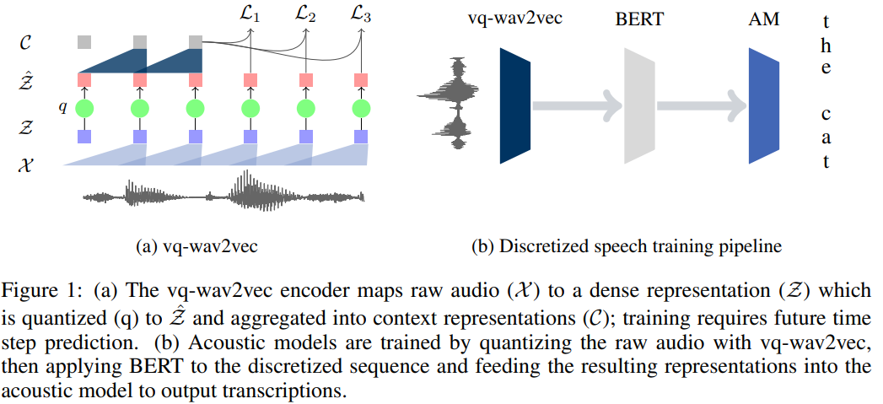
Vq-wav2vec
Baevski et al. FAIR. Feb 2020. https://arxiv.org/pdf/1910.05453.pdf
Notes:
先训练vq (contrastive)，再训练bert(MLM)，再用bert输出作为feature给ASR model
8 + 12 CNN
After training this model on 960h of Librispeech and quantizing the training dataset, we are left with 13.5k unique codewords combinations (out of V G = 102k possible codewords)

Slide 11
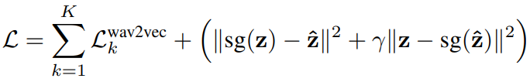
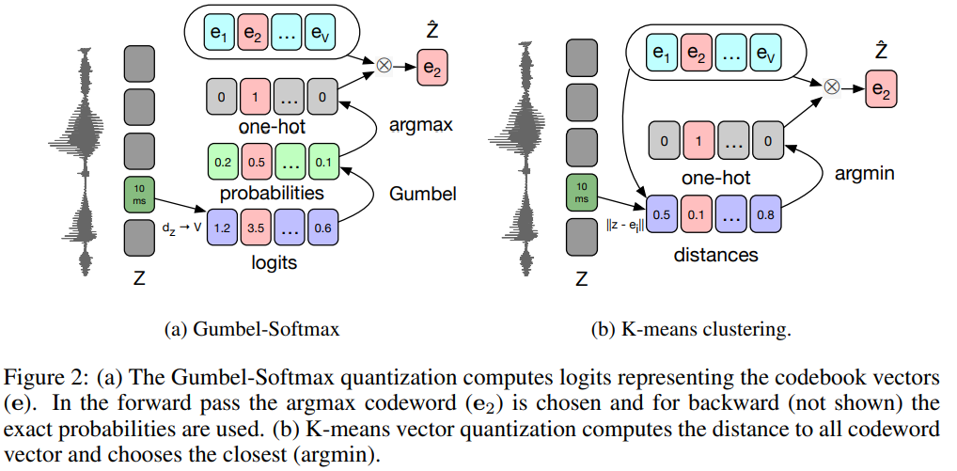
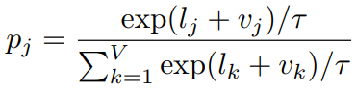
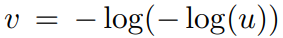
Vq-wav2vec
K-means clustering (VQ-VAE):
Gumbel-Softmax:
Baevski et al. FAIR. Feb 2020. https://arxiv.org/pdf/1910.05453.pdf
Notes:
先训练vq (contrastive)，再训练bert(MLM)，再用bert输出作为feature给ASR model
8 + 12 CNN
After training this model on 960h of Librispeech and quantizing the training dataset, we are left with 13.5k unique codewords combinations (out of V G = 102k possible codewords)

Slide 12
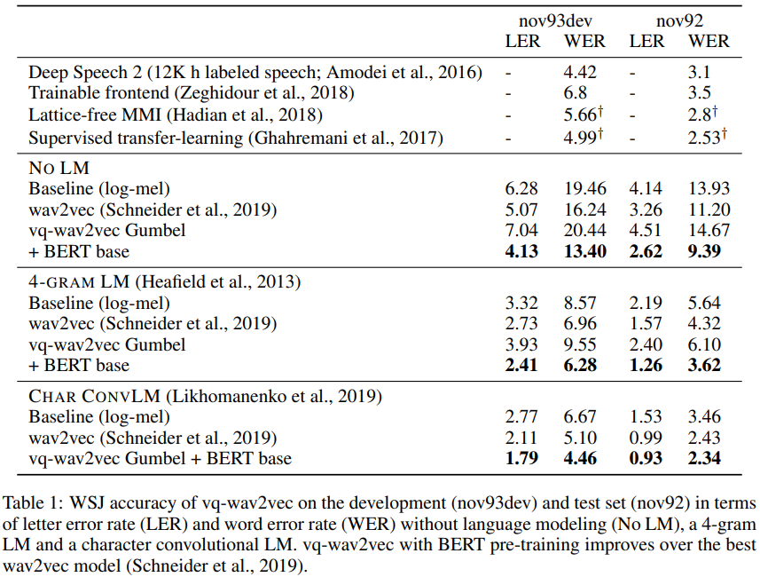
Vq-wav2vec
Baevski et al. FAIR. Feb 2020. https://arxiv.org/pdf/1910.05453.pdf
Notes:
vq-wav2vec with Gumbel-Softmax uses only 13.5k distinct codewords to represent the audio signal and this limited set of codewords is not sufficient to outperform the baseline.

Slide 13
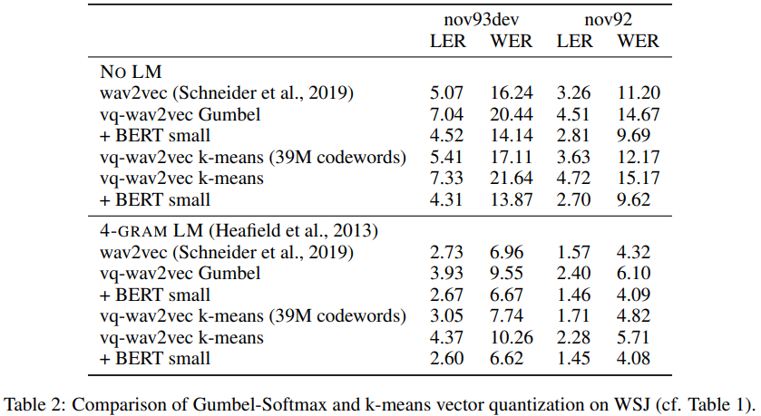
Vq-wav2vec
Baevski et al. FAIR. Feb 2020. https://arxiv.org/pdf/1910.05453.pdf
Notes:
After training this model on 960h of Librispeech and quantizing the training dataset, we are left with 13.5k unique codewords combinations (out of V G = 102k possible codewords)
Vq-wav2vec有差，加上bert差异消失
词表大小变大和wav2vec差距缩小

Slide 14
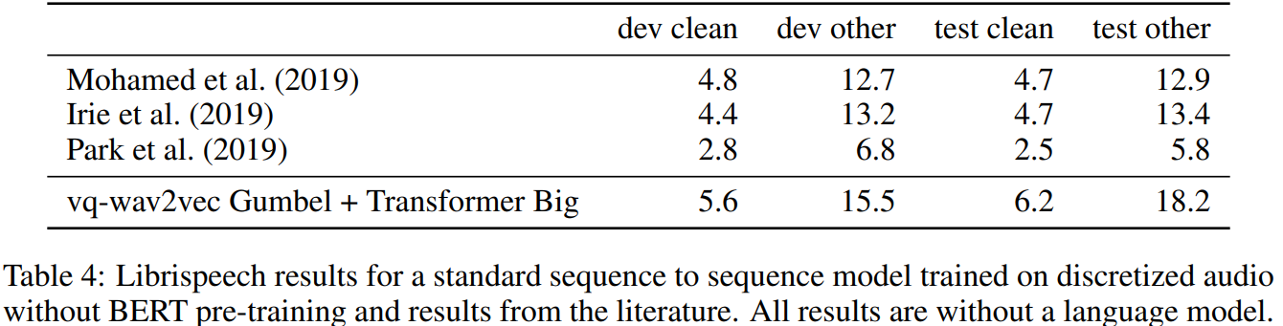
Vq-wav2vec
Baevski et al. FAIR. Feb 2020. https://arxiv.org/pdf/1910.05453.pdf
Notes:
Table 4 shows that results are promising, even though they are not as good as the state of the art (Park et al., 2019) which depends on data augmentation that we do not use.

Slide 15
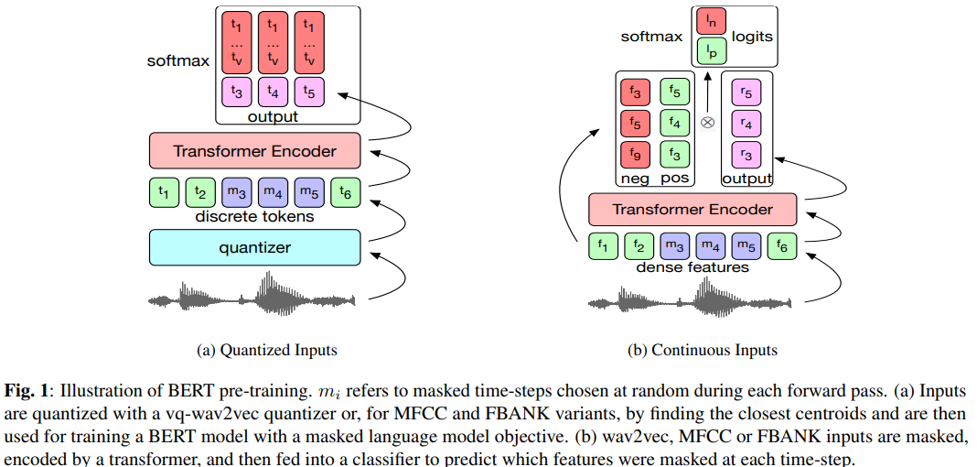
Discrete BERT
Baevski et al. FAIR. May 2020. https://arxiv.org/pdf/1911.03912.pdf
Notes:
Different to previous work, we directly fine-tune the pre-trained BERT models on transcribed speech using a Connectionist Temporal Classification (CTC) loss instead of feeding the representations into a task-specific model
Fine-tuning a BERT model on 10 hour of labeled Librispeech data with a vq-wav2vec vocabulary is almost as good as the best known reported system trained on 100 hours of labeled data on testclean, while achieving a 25% WER reduction on test-other.
When using only 10 minutes of labeled data, WER is 25.2 on test-other and 16.3 on test-clean. This demonstrates that self-supervision can enable speech recognition systems trained on a near-zero amount of transcribed data.

Slide 16
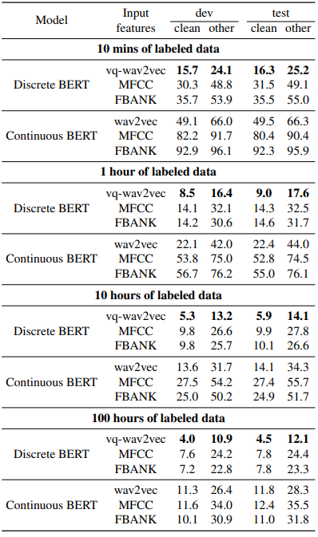
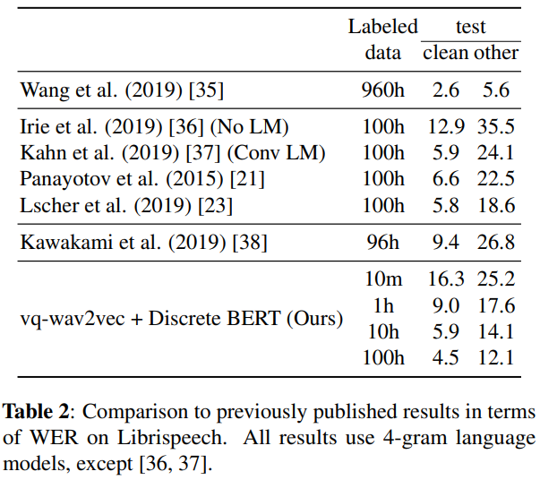
Discrete BERT
Baevski et al. FAIR. May 2020. https://arxiv.org/pdf/1911.03912.pdf
Notes:
Pre-training brings clear benefits: When reducing the amount of labeled training data from 100h to 10h results in an increase of only 2 WER on test-other and 1.4 WER on testclean for Discrete BERT with vq-wav2vec inputs.
Fine-tuning a BERT model on 10 hour of labeled Librispeech data with a vq-wav2vec vocabulary is almost as good as the best known reported system trained on 100 hours of labeled data on testclean, while achieving a 25% WER reduction on test-other.
When using only 10 minutes of labeled data, WER is 25.2 on test-other and 16.3 on test-clean. This demonstrates that self-supervision can enable speech recognition systems trained on a near-zero amount of transcribed data.

Slide 17
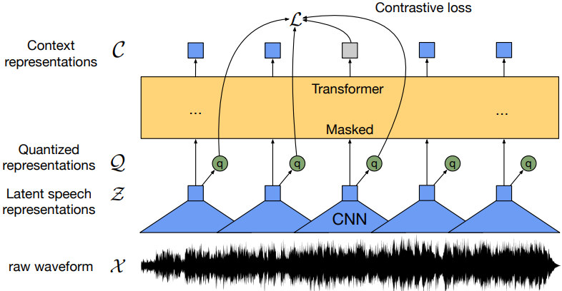
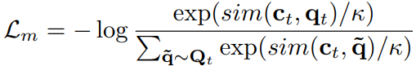
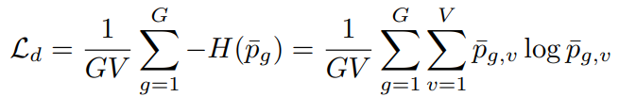
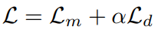
Wav2vec 2.0
Baevski et al. FAIR. Oct 2020. https://arxiv.org/pdf/2006.11477.pdf
Notes:
不需要预先训练离散特征，完全端到端，只加linear算CTC losswav2vec_presentation.pptx
Experiments using all labeled data of Librispeech achieve 1.8/3.3 WER on the clean/other test sets.
When lowering the amount of labeled data to one hour, wav2vec 2.0 outperforms the previous state of the art on the 100 hour subset while using 100 times less labeled data.
Using just ten minutes of labeled data and pre-training on 53k hours of unlabeled data still achieves 4.8/8.2 WER. T

Slide 18
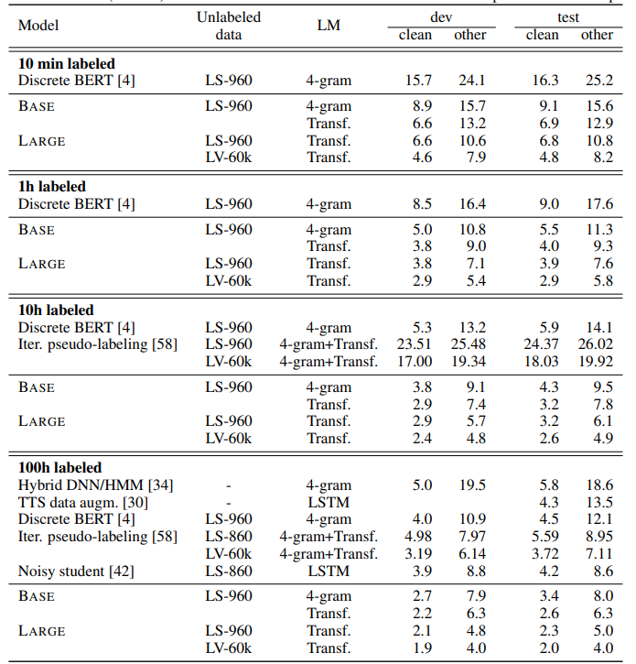
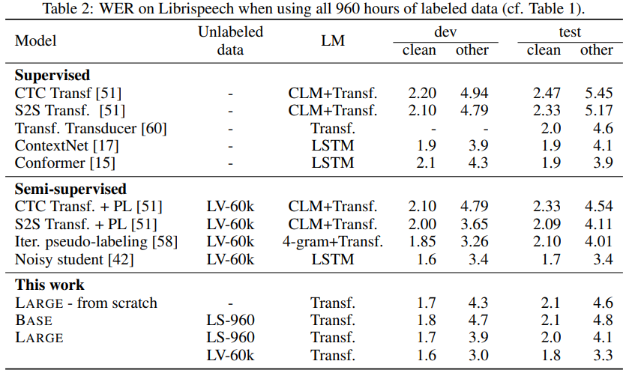
Wav2vec 2.0
Baevski et al. FAIR. Oct 2020. https://arxiv.org/pdf/2006.11477.pdf
Notes:
Experiments using all labeled data of Librispeech achieve 1.8/3.3 WER on the clean/other test sets.
When lowering the amount of labeled data to one hour, wav2vec 2.0 outperforms the previous state of the art on the 100 hour subset while using 100 times less labeled data.
Using just ten minutes of labeled data and pre-training on 53k hours of unlabeled data still achieves 4.8/8.2 WER. This demonstrates that ultra-low resource speech recognition is possible with self-supervised learning on unlabeled data

Slide 19
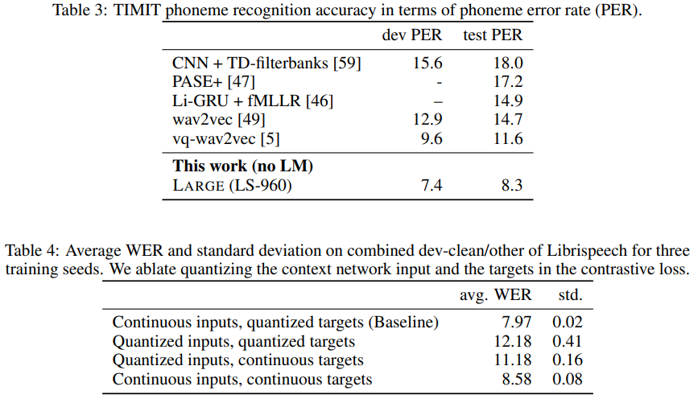
Wav2vec 2.0
Baevski et al. FAIR. Oct 2020. https://arxiv.org/pdf/2006.11477.pdf
Notes:
Continuous latent speech representations retain more information to enable better context representations and quantizing the target representations leads to more robust training
Quantizing the latents both in the input and the targets performs least well, and explains the lower performance of prior work
Continuous targets reduce the effectiveness of self-supervised training since targets can capture detailed artifacts of the current sequence, e.g. speaker and background information

Slide 20
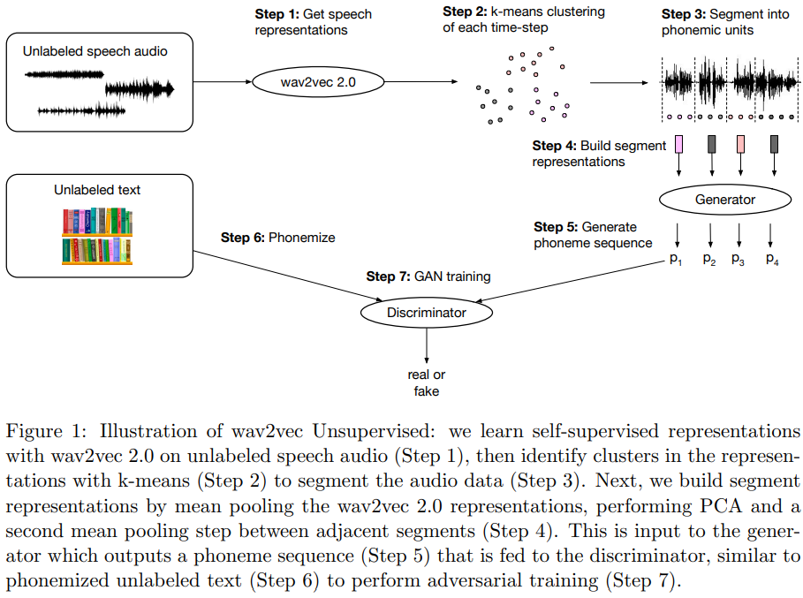
wav2vec-U
Audio
Removing Silences
With unsupervised voice activity detection model rVAD
Speech Audio Representations
evaluate phoneme error rate on each hidden state
Layer 15 perform best.
Segmentation
K-means clustering
PCA + mean-pooling
Text
Text -> phoneme
Insert silence token
Baevski et al. FAIR. Oct 2021. https://arxiv.org/pdf/2105.11084.pdf
Notes:
Compared to the best previous unsupervised work, wav2vec-U reduces the phoneme error rate on the TIMIT benchmark from 26.1 to 11.3.
On the larger English Librispeech benchmark, wav2vec-U achieves a word error rate of 5.9 on test-other, rivaling some of the best published systems trained on 960 hours of labeled data from only two years ago.
Our unsupervised speech recognition model, the generator, is very lightweight: it consists of a single temporal convolution comprising only about 90k parameters to which we input frozen wav2vec 2.0 representations

Slide 21
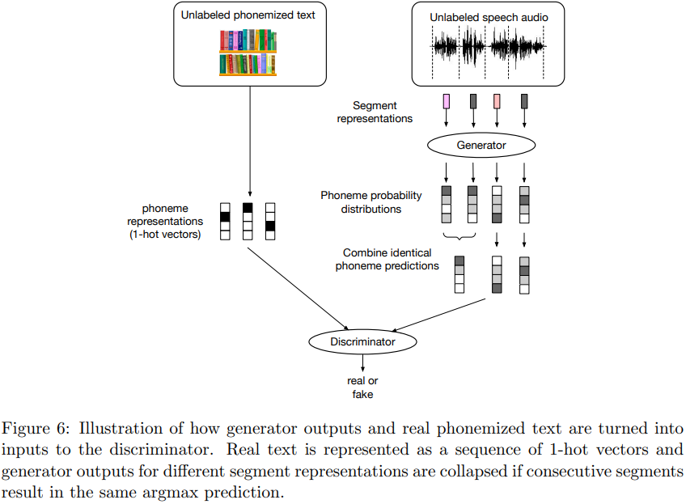
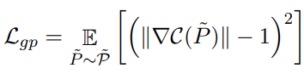
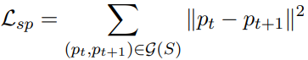
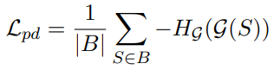
wav2vec-U
GAN Loss:
Gradient penalty:
Segment smoothness penalty:
Phoneme diversity loss:
Baevski et al. FAIR. Oct 2021. https://arxiv.org/pdf/2105.11084.pdf
Notes:
Compared to the best previous unsupervised work, wav2vec-U reduces the phoneme error rate on the TIMIT benchmark from 26.1 to 11.3.
On the larger English Librispeech benchmark, wav2vec-U achieves a word error rate of 5.9 on test-other, rivaling some of the best published systems trained on 960 hours of labeled data from only two years ago.
Our unsupervised speech recognition model, the generator, is very lightweight: it consists of a single temporal convolution comprising only about 90k parameters to which we input frozen wav2vec 2.0 representations

Slide 22
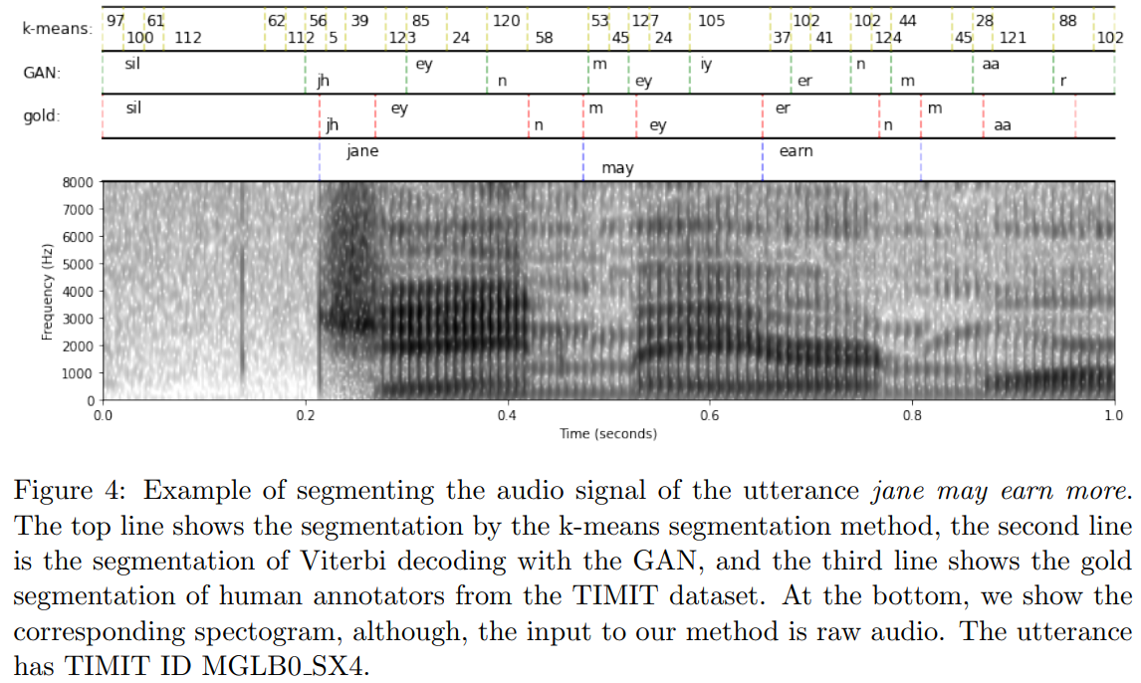
wav2vec-U
Baevski et al. FAIR. Oct 2021. https://arxiv.org/pdf/2105.11084.pdf
Notes:
Compared to the best previous unsupervised work, wav2vec-U reduces the phoneme error rate on the TIMIT benchmark from 26.1 to 11.3.
On the larger English Librispeech benchmark, wav2vec-U achieves a word error rate of 5.9 on test-other, rivaling some of the best published systems trained on 960 hours of labeled data from only two years ago.
Our unsupervised speech recognition model, the generator, is very lightweight: it consists of a single temporal convolution comprising only about 90k parameters to which we input frozen wav2vec 2.0 representations

Slide 23
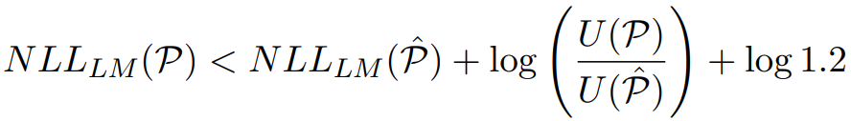
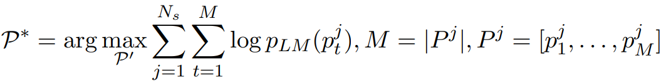
wav2vec-U
Cross-Validation Metric
LM negative log-likelihood (NLL)
vocabulary usage
Select the best model with
Choose the model that satisfies
Get the best model with
Self-training:
pseudo-label the training data with the unsupervised GAN model and train an HMM on the pseudo-labels
relabel the training data with the HMM and then fine-tune the original wav2vec 2.0 model using the HMM pseudo-labels
Baevski et al. FAIR. Oct 2021. https://arxiv.org/pdf/2105.11084.pdf
Notes:
Compared to the best previous unsupervised work, wav2vec-U reduces the phoneme error rate on the TIMIT benchmark from 26.1 to 11.3.
On the larger English Librispeech benchmark, wav2vec-U achieves a word error rate of 5.9 on test-other, rivaling some of the best published systems trained on 960 hours of labeled data from only two years ago.
Our unsupervised speech recognition model, the generator, is very lightweight: it consists of a single temporal convolution comprising only about 90k parameters to which we input frozen wav2vec 2.0 representations

Slide 24
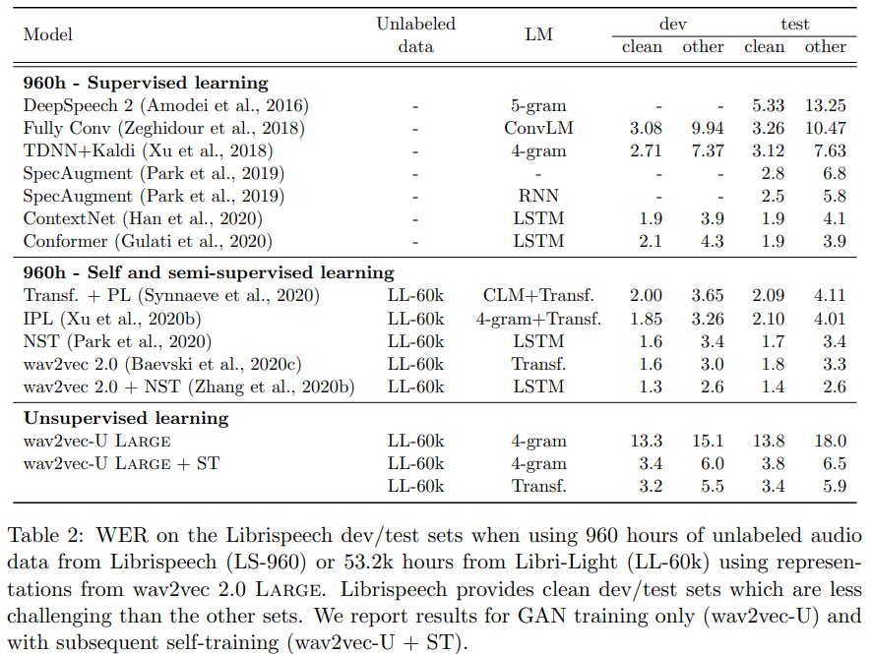
wav2vec-U
Baevski et al. FAIR. Oct 2021. https://arxiv.org/pdf/2105.11084.pdf
Notes:
Compared to the best previous unsupervised work, wav2vec-U reduces the phoneme error rate on the TIMIT benchmark from 26.1 to 11.3.
On the larger English Librispeech benchmark, wav2vec-U achieves a word error rate of 5.9 on test-other, rivaling some of the best published systems trained on 960 hours of labeled data from only two years ago.
Our unsupervised speech recognition model, the generator, is very lightweight: it consists of a single temporal convolution comprising only about 90k parameters to which we input frozen wav2vec 2.0 representations
For self-training, we perform two iterations: first, we pseudo-label the training data with the unsupervised GAN model and train an HMM on the pseudo-labels (§ 2.2). Second, we relabel the training data with the HMM and then fine-tune the original wav2vec 2.0 model using the HMM pseudo-labels with a CTC loss (§ 2.3)

Slide 25
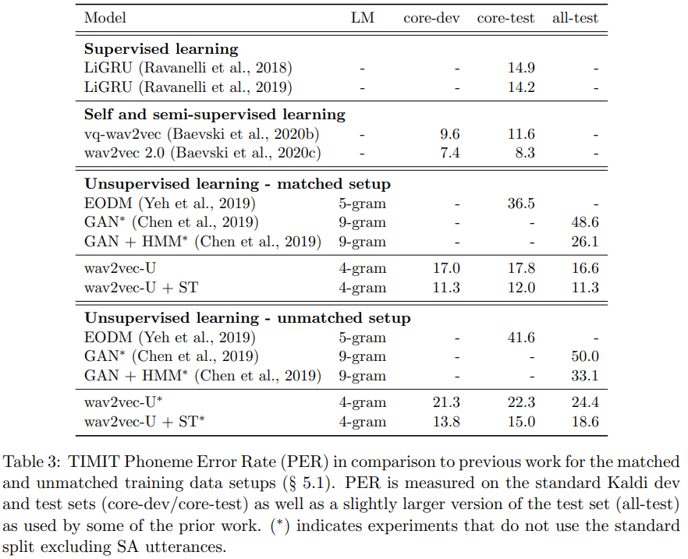
wav2vec-U
Baevski et al. FAIR. Oct 2021. https://arxiv.org/pdf/2105.11084.pdf
Notes:
Compared to the best previous unsupervised work, wav2vec-U reduces the phoneme error rate on the TIMIT benchmark from 26.1 to 11.3. SOTA 8.3
On the larger English Librispeech benchmark, wav2vec-U achieves a word error rate of 5.9 on test-other, rivaling some of the best published systems trained on 960 hours of labeled data from only two years ago.
Our unsupervised speech recognition model, the generator, is very lightweight: it consists of a single temporal convolution comprising only about 90k parameters to which we input frozen wav2vec 2.0 representations
For self-training, we perform two iterations: first, we pseudo-label the training data with the unsupervised GAN model and train an HMM on the pseudo-labels (§ 2.2). Second, we relabel the training data with the HMM and then fine-tune the original wav2vec 2.0 model using the HMM pseudo-labels with a CTC loss (§ 2.3)

Slide 26
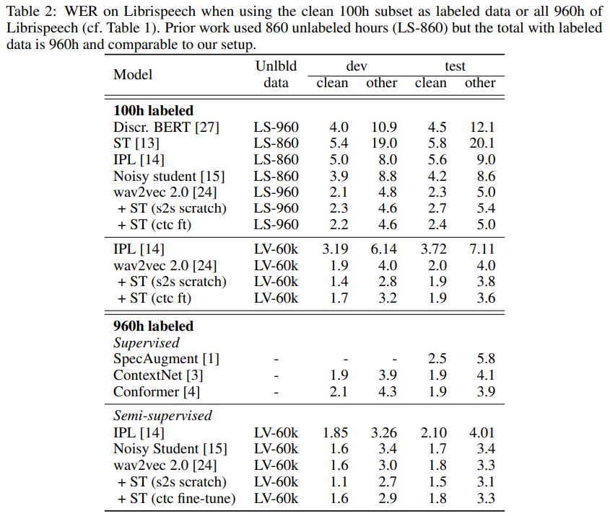
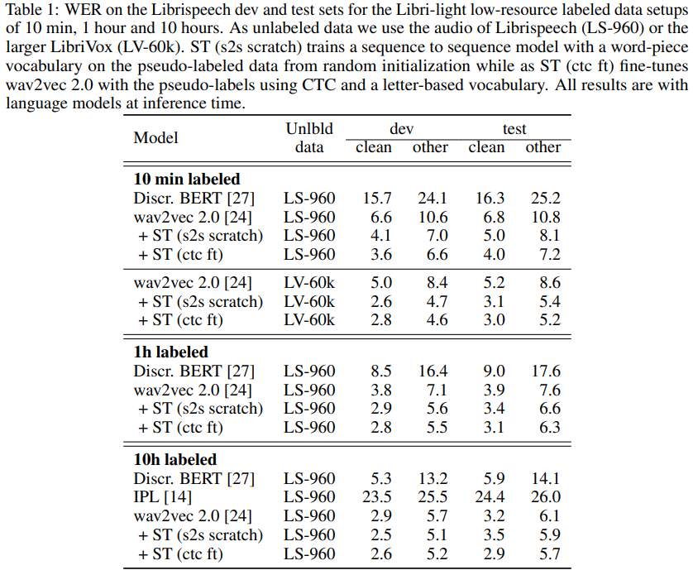
Wav2vec 2.0 + Self-Training
Xu and Baevski et al. FAIR. Oct 2020. https://arxiv.org/pdf/2010.11430.pdf
Notes:
Using just 10 minutes of labeled data from Libri-light as well as 53k hours of unlabeled data from LibriVox achieves WERs of 3.0%/5.2% on the clean and other test sets of Librispeech – rivaling the best published systems trained on 960 hours of labeled data only a year ago.
Training on all labeled data of Librispeech achieves WERs of 1.5%/3.1%.
we first pre-train a wav2vec 2.0 model on the unlabeled data, fine-tune it on the available labeled data, use the model to label the unlabeled data, and finally use the pseudo-labeled data to train the final model. In our experiments, we also consider a variant where we fine-tune the original wav2vec 2.0 model on the pseudo-labeled data.
The lower performance of fine tuning is likely due to CTC not being as competitive as more elaborate sequence to sequence models when a lot of pseudo-labeled data is available

Slide 27
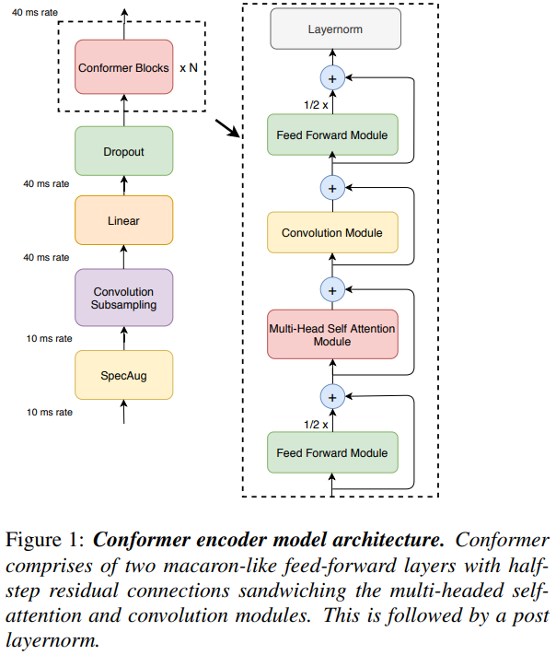
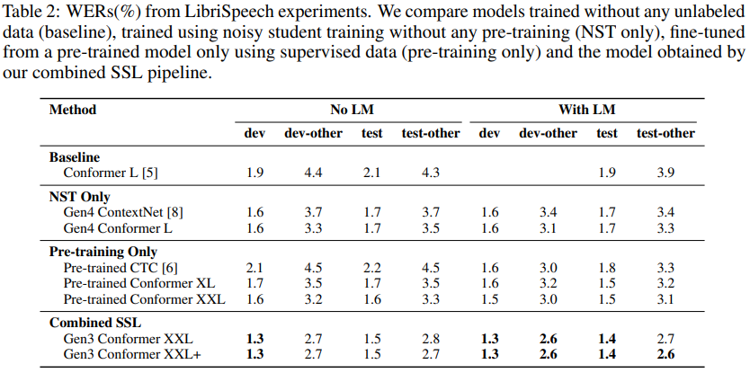
Wav2vec 2.0 + Conformer + NST
Conformer Model
Wav2vec 2.0 pretraining
Noisy Student Training
Generate pseudo labels with finetuned pretrained model
Fine-tune new pre-trained on the mixed datasets
Zhang et al. Google Brain. Oct 2020. https://arxiv.org/pdf/2010.10504.pdf
Notes:
Conformer XL and Conformer XXL, which have 600M and 1B parameters, Conformer XXL and Conformer XXL+ as having the same pre-trained sub-model with different projection blocks
Noisy Student Training: 1 Generate pseudo labels with finetuned pretrained model, 2. Fine-tune new pre-trained on the mixed datasets , 3. repeat
we have been unsuccessful in achieving gains from training Conformer XL and XXL from scratch, and only present the performance we obtained by fine tuning pre-trained models on LibriSpeech for these models
First, we use the log-mel spectrogram instead of the waveform as the input for the ASR network. Secondly, we do not use quantization or a diversity loss for simplicity.
LSTM decoder

Slide 28
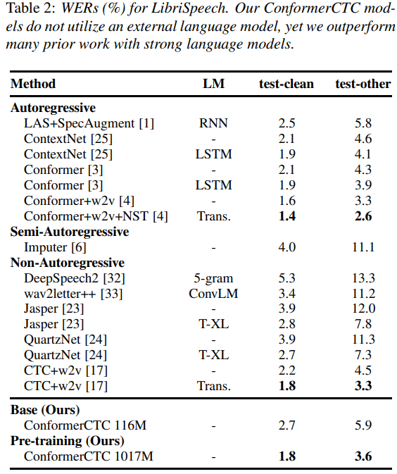
Wav2vec 2.0 + Conformer (Non-Autoregressive)
Non-Autoregressive Speech Recognition
CTC loss (w/o sequential decoder)
w/o LM
Ng et al. Google Brain. Sep 2021. https://arxiv.org/pdf/2104.03416.pdf
Notes:
Using just 10 minutes of labeled data from Libri-light as well as 53k hours of unlabeled data from LibriVox achieves WERs of 3.0%/5.2% on the clean and other test sets of Librispeech – rivaling the best published systems trained on 960 hours of labeled data only a year ago.
Training on all labeled data of Librispeech achieves WERs of 1.5%/3.1%.
we first pre-train a wav2vec 2.0 model on the unlabeled data, fine-tune it on the available labeled data, use the model to label the unlabeled data, and finally use the pseudo-labeled data to train the final model. In our experiments, we also consider a variant where we fine-tune the original wav2vec 2.0 model on the pseudo-labeled data.
The lower performance of fine tuning is likely due to CTC not being as competitive as more elaborate sequence to sequence models when a lot of pseudo-labeled data is available

Slide 29
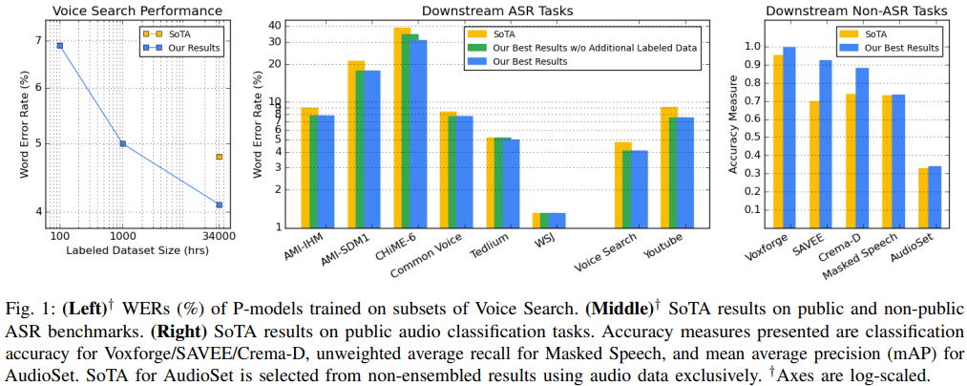
BigSSL
Conformer Model
Params size: 600M to 8B
Training data: 1m hrs Youtube
Wav2vec 2.0 pretraining
Noisy Student Training
Zhang et al. Google Brain. Oct 2021. https://arxiv.org/pdf/2109.13226.pdf
Notes:
SSL + Large Models = Labeled Data Efficiency
SoTA results for downstream ASR tasks
SoTA results for downstream non-ASR tasks
Benefits of using SSL + Large Models are smaller for bigger downstream tasks, but are still significant:

Slide 30
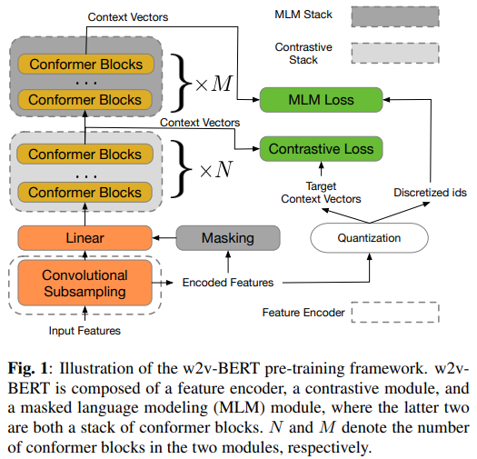
w2v-BERT
Chung et al. Google Brain. Sep 2021. https://arxiv.org/pdf/2108.06209.pdf
Notes:
SSL + Large Models = Labeled Data Efficiency
SoTA results for downstream ASR tasks
SoTA results for downstream non-ASR tasks
Benefits of using SSL + Large Models are smaller for bigger downstream tasks, but are still significant:

Slide 31
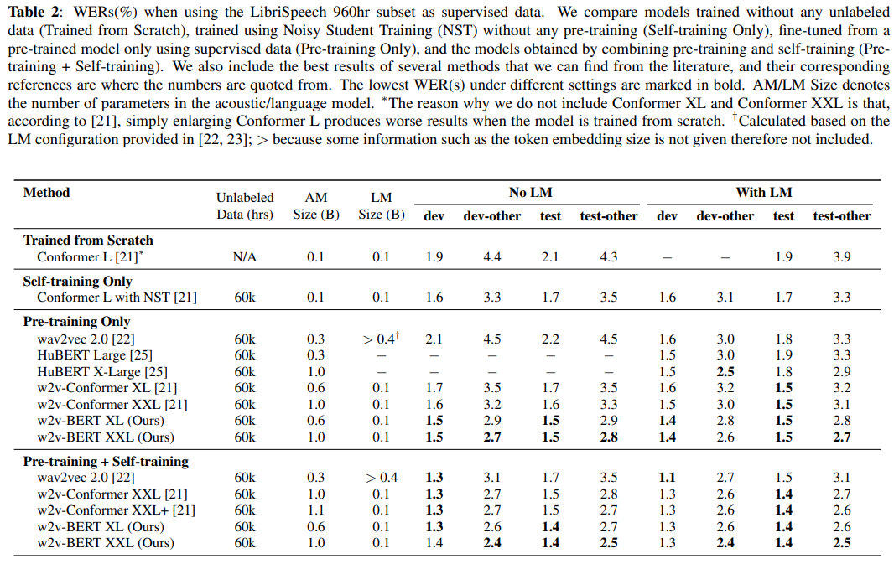
w2v-BERT
Chung et al. Google Brain. Sep 2021. https://arxiv.org/pdf/2108.06209.pdf
Notes:
Without self-training and LM, w2v-BERT already either outperforms or matches other models with LM
Contrastive learning combined with masked language modeling is more effective than contrastive learning alone
On the necessity of contrastive module: always assigning the same target ID for the masked prediction module to predicton

Slide 32
Thanks

Slide 33
Paper list
CPC: https://arxiv.org/abs/1807.03748 ,
Modified CPC: https://arxiv.org/pdf/2002.02848.pdf
Wav2vec: https://arxiv.org/abs/1904.05862
Vq-wav2vec: https://arxiv.org/pdf/1910.05453.pdf
Discrete BERT: https://arxiv.org/pdf/1911.03912.pdf
Compare vq-vae: https://arxiv.org/pdf/2010.14230.pdf
Wav2vec 2.0 https://arxiv.org/abs/2006.11477
XLSR (cross-lingual): https://arxiv.org/pdf/2006.13979.pdf
XLS-R XLSR (cross-lingual at scale): https://arxiv.org/pdf/2111.09296.pdf
Robust wav2vec 2.0 (Multi-domain) https://arxiv.org/pdf/2104.01027.pdf
Wav2vec-u: https://arxiv.org/pdf/2105.11084.pdf
wav2vec 2.0 + Self-training: https://arxiv.org/pdf/2010.11430.pdf
wav2vec 2.0 + Conformer + Self-training: https://arxiv.org/pdf/2010.10504.pdf
wav2vec 2.0 + Conformer + Self-training (Non-Autoregressive): https://arxiv.org/pdf/2104.03416.pdf
BigSSL: https://arxiv.org/pdf/2109.13226.pdf
Unispeech: https://arxiv.org/pdf/2101.07597.pdf https://arxiv.org/pdf/2107.05233.pdf
Wav2vec-Switch: https://arxiv.org/pdf/2110.04934.pdf
W2v-bert: https://arxiv.org/pdf/2108.06209.pdf
Slam: https://arxiv.org/pdf/2110.10329.pdf

